Slide 1



a00s3e3 - DONE
F= -1.77969
F = -1.77893
F= -1.77588, unstable

Slide 2










a00s5e3 - DONE
F = -2.986
F = -2.98574
F = -2.98733
F = -2.98580
F = -2.98637
F = -2.98644

Slide 3


a00s6e3 - DONE
F = -3.59170
F = -3.59404

Slide 4


a00s7e3 - DONE
F = -4.20090
F = -4.20224
Terran tried stripe (15.2, 20.2) & (12.2, 20.2). Unstable

Slide 5



a05s3e3 - DONE
F = -1.77283
F = -1.77232
F = -1.77005

Slide 6



a05s5e3 - DONE
F = -2.97229
F = -2.97422
F = -2.97365

Slide 7



a05s6e3 - TERRAN
F = -3.57664
F = -3.57732
F = -3.57783

Slide 8



a05s7e3 - DONE
F = -4.18090
F = -4.18116
F = -4.18226

Slide 9
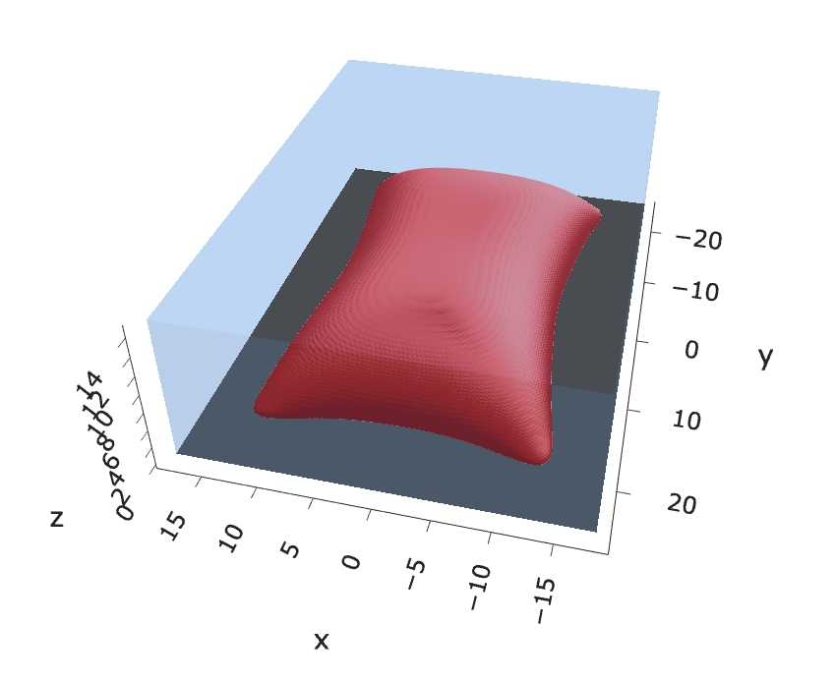
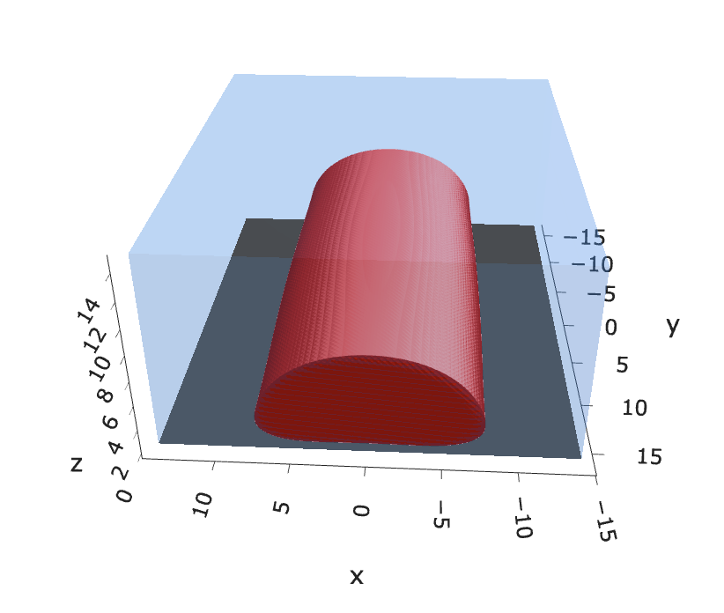
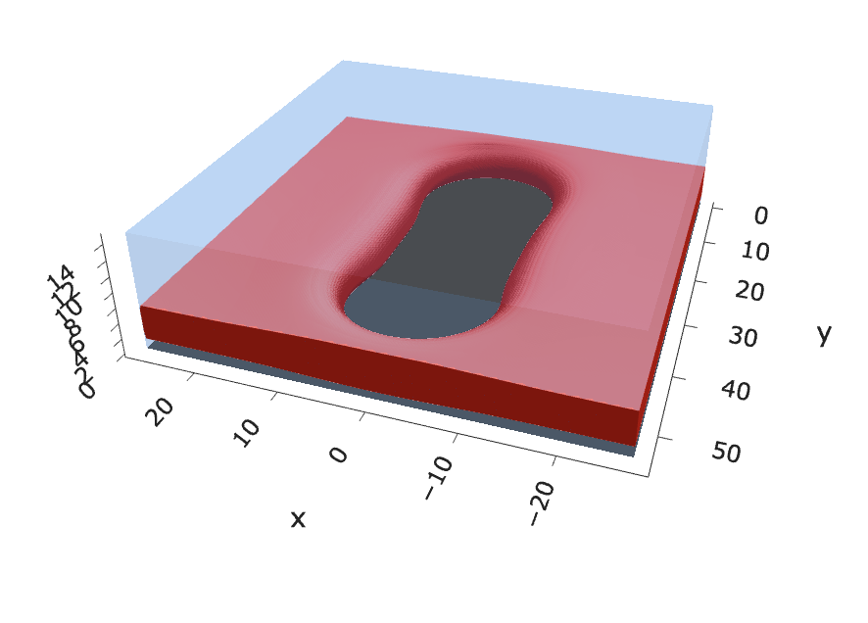
a10s2.5e3 - JOSH

Slide 10



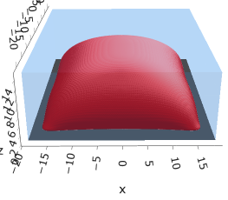


a10s5e3
F = -2.93703
F = -2.93851
F = -2.93859
F = -2.93788

Slide 11


a10s0075 - JOSH
F = -4.42429
F = -4.42466

Slide 12


a10s010 - DONE
F = -5.90899
F = -5.90938
Josh tried hole. Unstable

Slide 13



a15s5e3 - TERRAN
F = -2.88591
F = -2.88482
F = -2.88653
Mic again, init_opt = -99

Slide 14
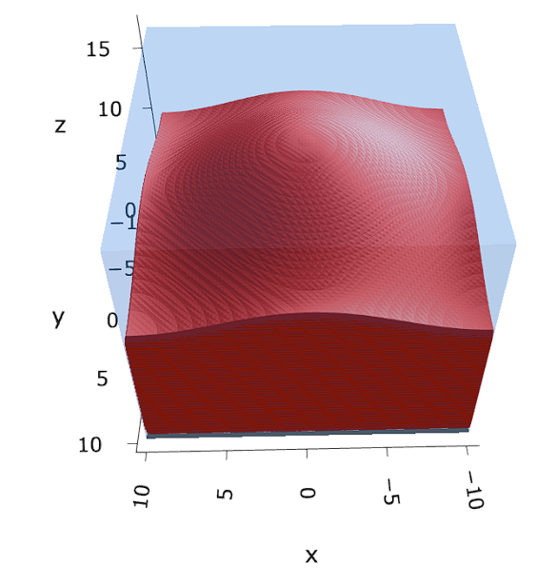

a15s1e2 - TERRAN
F = -5.78550
F = -5.78568
F = -5.78574

Slide 15

a20s5e3
F = -2.82020
No hol mic?

Slide 16

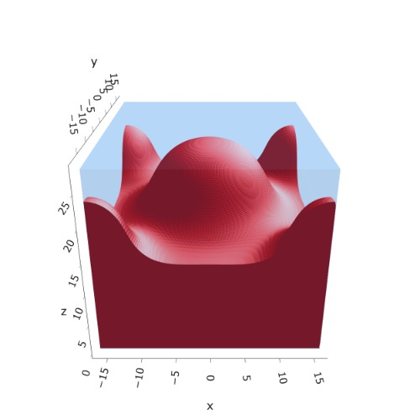

a20s015
F = -8.43956
F = -8.43935
F = -8.43930
n_coarse = 2
n_coarse = 2

Slide 17



a20s0175
F = -9.83777
F = -9.83863
F = -9.83859
n_coarse = 2

Slide 18




a20s020
F = -11.2312
F = -11.2319
F = -11.2321
n_coarse = 2

Slide 19



a20s022 – DONE
F = -12.3420
F = -12.3429
F = -12.3433

Slide 20




a20s025 - DONE
F = -14.0028
F = -14.0029
F = -14.0033
F = -13.9755

Slide 21




a20s027 - DONE
F = -15.1049
F = -15.1047
F = -15.0898
F = -15.1050

Slide 22
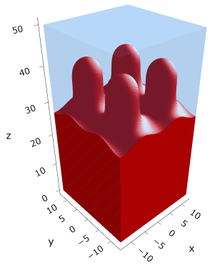



a25s027
F = -14.6057
F = -14.6022
F = -14.6018
F = -14.6015

Slide 23





a25s030
F = -16.1888
F = -16.1858
F = -16.1857
F = -16.1854
F = -16.1854
Pn?

Slide 24

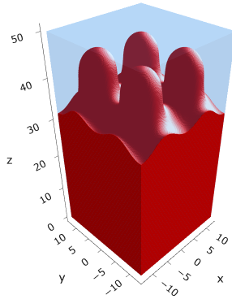
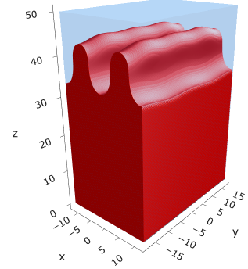



a25s0325
F = -17.4973
F = -17.4995
F = -17.4998
F = -17.4971
F = -17.4975
F = -17.4968

Slide 25
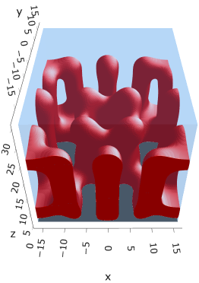
a30s005
F = -2.68997

Slide 26

a30s015

Slide 27

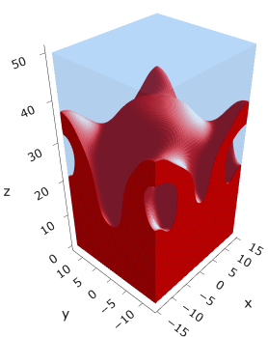


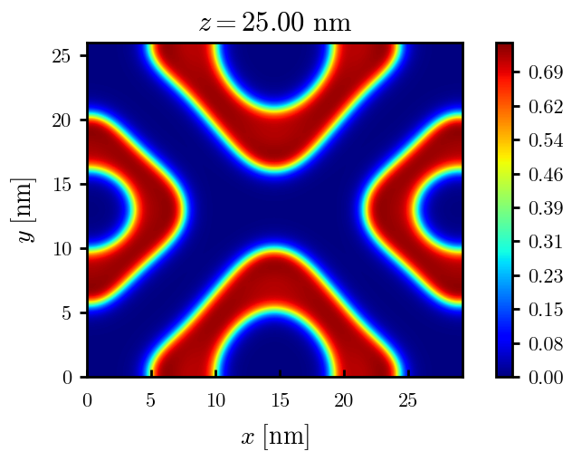
a30s020
F = -10.5091
F = -10.4996
F = -10.4878
F = -10.4764

Slide 28




a30s025
F = -13.0657
F = -13.0548
F = -13.0538
F = -13.0394

Slide 29




a30s030
F = -15.5953
F = -15.5886
F = -15.5897
F = -15.5739

Slide 30




a30s0325
F = -16.8486
F = -16.8312
F = -16.8491
F = -16.8268
2C isomin = 0.5

Slide 31






a30s035
F = -18.0779
F = -18.0943
F = -18.0948
F = -18.0946
F = -18.0887
F = -18.0782

Slide 32









a30s040
dz =0.15
F = -20.5583
F = -20.5585
F = -20.5582
F = -20.5549
F = -20.5390
F = -20.5384

Slide 33
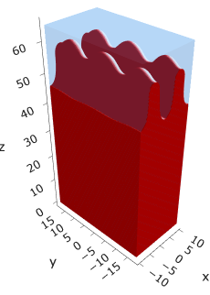





a30s045
n_coarse = 2
dz =0.15
F = -22.9834
F = -22.9822
F = -22.9788
F = -22.9692
F = -22.9716

Slide 34

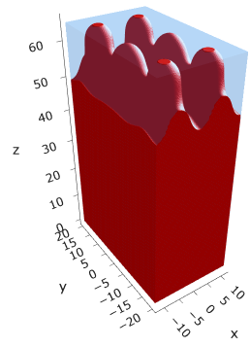

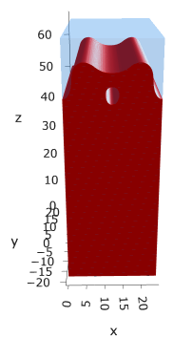

a30s050
dz =0.15
F = -25.3645
F = -25.3638
F = -25.3570
F = -25.3553
F = -25.3480

Slide 36
2 pn?

Slide 38




a30s020, chi = 1.35
F = -10.3763
F = -10.3644
F = -10.3602
F = -10.3437

Slide 39





a30s040, chi = 1.35
F = -20.3489
F = -20.3492
F = -20.3446
F = -20.3275
F = -20.3219

Slide 40


a325s020
F = -10.2994
F = -10.2821

Slide 41




a35s020
Cyl?
3 “layers”
+1 dilute layer < isomin = 0.1

Slide 42





a35
s10
s12
s15
s18

Slide 43



Parallelization
$$α=0, χ=1.25, N=50, σ=0.02$$
$$α=0, χ=1.25, N=200, σ=0.005$$
$$L_{x}=L_{y}=23, { L}_{z}=15$$
Nth = 12: 500 it, 4.3 hrs
Nth = 8 : 500 it, 6.9 hrs
Nth = 6 : 415 it, 20 hrs (poss. mem bottleneck)

Slide 44







Exercise: Micelle / Stripe
s = 5e-03, N = 50, a = 0.0, x = 1.0
s = 5e-03, N = 75, a = 0.0, x = 1.0
Isosurface at pha = 0.1

Slide 45






a040x170s020

Slide 46






a040x170s010

Slide 47

a040x170s025

Slide 48














a040x170s022

Slide 49










a040x170 seed
See if becomes hex
cyl4-975
cyl4-12
cyl16-975
cyl16-1025
cyl1

Slide 50






a040x170s017

Slide 51












































a040x170s015 seed
Almost done
Almost done

Slide 52

















a040x170s013

Slide 53
















a040x170s010 seed

Slide 54














X200 x170 x130 x120 x100
F = −10.24458
F = − 9.14301
F = −11.0057
F = −10.2429
F = −11.0015
F = −9.63949
F = −10.2461
F = −10.9948
F = − 9.63030
F = −10.2431
F = −10.9953

Slide 55





a040x100 relaxation

Slide 56








































a040x100 seed
old
old

Slide 57


a040x120 relaxation
F = −10.24458

Slide 58





































a040x120 seed
cyl16-850
cyl16-825

Slide 59






a040x130 relaxation

Slide 60




a040x170 relaxation
F = −9.10347
1 neck

Slide 61







a040x200 relaxation

Slide 62










a040x200 seed
Note: not completely converged but stopped for resources

Slide 64


a0.40 x1.70

Slide 65





Zhulina JCP 1998
a = 0.01
0.1 mM
1 mM
May need to init using sine
10 mM
25 mM
Zhulina NVT; current GCE runs at Lz = 20

Slide 66

Carrillo Langmuir 2009

Slide 67

Parallelization

Slide 68
Equations
Quenched average, np, A --> \inf ; np/A → \sigma
Discrete Gaussian chain

Slide 69




Scaling (Alexander—de Gennes brush)
V = 4.2; H = 27.5 – 30.5
V = 2; H = 39 – 45.5

Slide 70






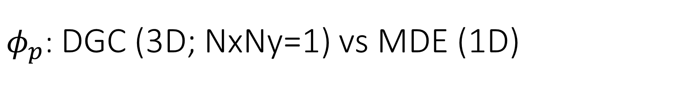
$φ_{p}$: DGC (3D; NxNy=1) vs MDE (1D)
Ns/sigs: dz = 0.10, Ngz_2 = 4$σ$; Chis/bs: dz = 0.25, Ngz_2 = 3.5$σ$

Slide 71


Numericals
Ys
Possibly do Ngz for multiple dzs

Slide 72








3D
Lxy = 1
Lxy = 10
Lxy = 5
Lxy = 15
y-z heatmaps for $φ_{p}$ at constant x

Slide 73





z-FFT vs z-FD (MDE) – REDFT01 xy(z)
Lx = 5, Ly = 5, Lz = 50. s = 0.02. x = 0.75. a = 0.00, N = 50
3D vs 1D (dashed): dz = 0.5, ds = 0.20; dz_1D = 0.113, ds_1D = 0.083
FFT (xyz)
FFT (yz vs pha)
FD (xyz)
FD (yz vs pha)
Diff btw 1D/3D should just be dz, ds, etc.

Slide 74
Specifying Grafted Points

Slide 75
Strategy
2D binary array for surface sites of homogeneously grafted polymer given grafting density, simulation box size, and discretization (and assuming dx = dy)
Fullspace must be periodic on x0 = xL, y0 = yL
Halfspace must be even on xL/2 and yL/2 (overlap of boundary following REDFT00) and periodic on x0 = xL, y0 = yL.
Homogeneous spacing as determined by regular hexagon, where grafting point at centroid of hexagon
In case there are edge effects, try shifting the centroids away from the boundaries of the xy-plane (only did for fullspace)
Make sure no edge effects by comparing results of full FFT with cos FFT

Slide 76
Test conditions
Sigma = 0.05 c/nm2
Lx = 15 nm
Ly = 15 nm
dx = 0.4 nm
Cast in terms of dx (for rounding and PBC for grafting points):
Sigma = 0.0668 c/nm2
Lx = 14.80 nm
Ly = 11.20 nm
(Sigma error decrease with dx)

Slide 77

Padded PBC (Full FFT)
Hexagons drawn for illustration of hexagon approach

Slide 78

Unpadded PBC (Full/Cos FFT)

Slide 79






Other conditions (full and half results overlapped to show match)
s = 0.0241 (20.28%; dx=0.4), Lx, Ly = 12.40, 20.80
s = 0.0208 (4.08%; dx=0.1), Lx, Ly = 12.90, 22.30
s = 0.1332 (11%; dx=0.1), Lx, Ly = 20.50, 20.40

